Slide 1
Lesson 1
Introduction to Spark

Slide 2
Why can’t we stick with MapReduce?
MapReduce can get slow
It uses hard disk
It can’t process real-time data

Slide 3
The solution: Spark
It’s up to 100x faster than MapReduce
It uses RAM which is efficient for multitasking
It can use streaming for real-time data processing
It uses lazy evaluation
my_string = 'Hello World!'.lower()
my_string.print()
Notes:
Lazy evaluation is when the computer doesn’t execute your code when it runs it, only later once it’s needed

Slide 4











What is Apache Spark?
Spark is an analytics engine (but we’ll just call it a library)
SparkContext or SparkSession
Notes:
Spark is an analytics engine that we can use to process big data, just like we were using MapReduce.
Here is our Spark Context or Spark Session
This is the driver. He manages all the stuff behind the scenes, and he’s the one we talk to about our packages. He also does other things like task scheduling, and block managing, which we aren’t going into right now
This is the cluster manager. He sits behind the driver. The driver tells him what needs delivering, and he decides which delivery teams are available for delivery (does the resource allocation).
Then, when they pick up a delivery (process an RDD), it’s split into multiple packages and each package is given to a team worker, who takes care of delivering it.
A worker can keep hold of to a package until it’s needed.

Slide 5
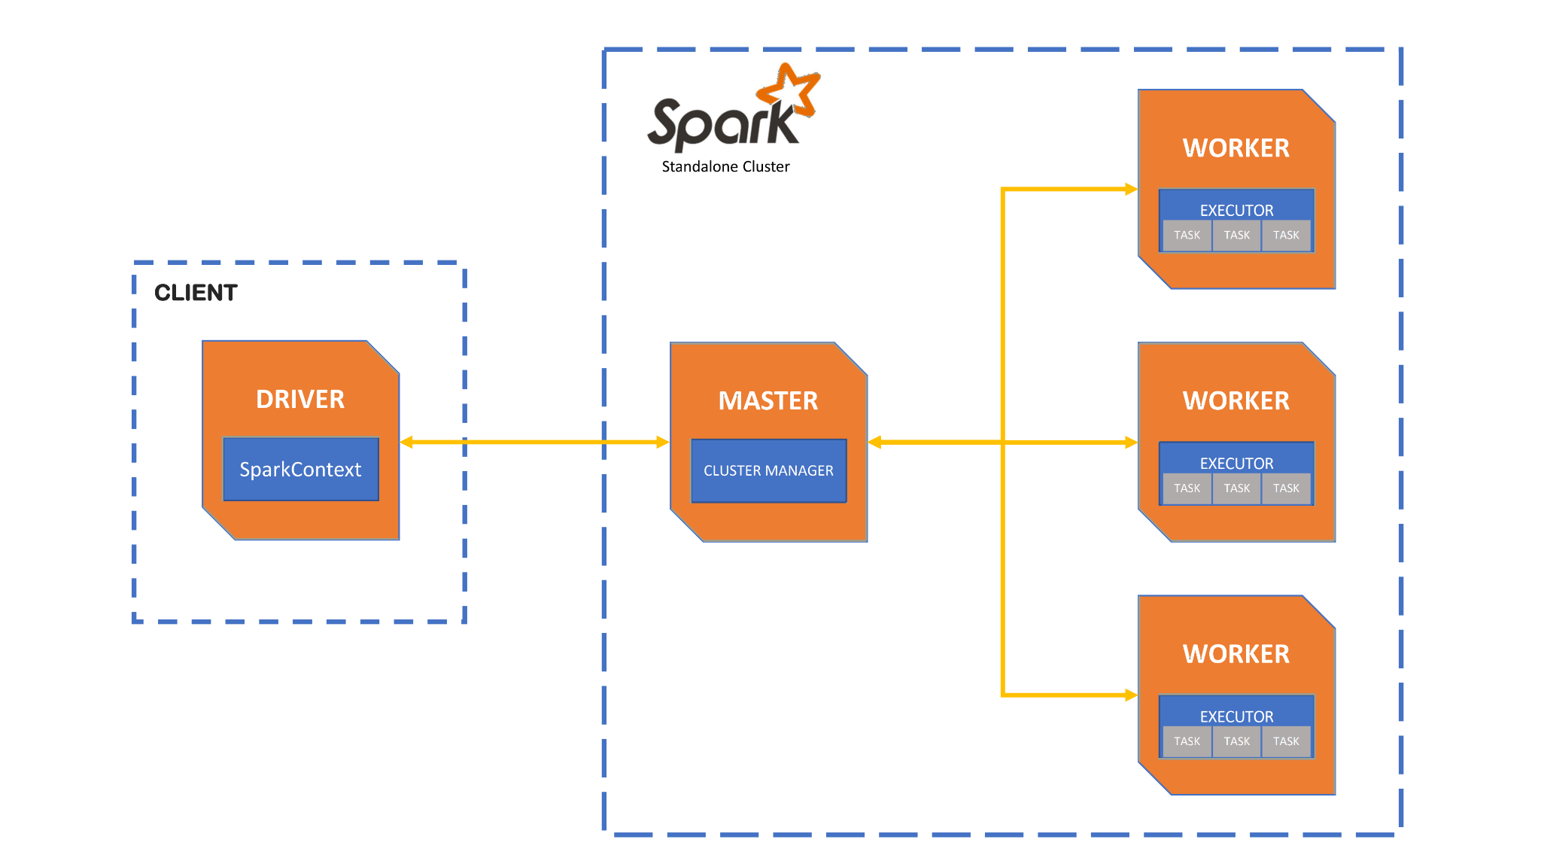
Spark Architecture: A diagram
Notes:
Spark executors: or “workers” - receive tasks from the cluster manager, perform the tasks, and return state and values to the cluster manager. Each spark application (SparkContext) has its own, so memory can’t be shared.
Cluster manager: manages a cluster of machines that will run the spark applications. Might provide a space for the driver, or just for the executors.
Spark driver: is the “interface”, the controller of execution of a spark application. To get physical resources and launch executors, you ask the driver to ask the cluster manager.

Slide 6
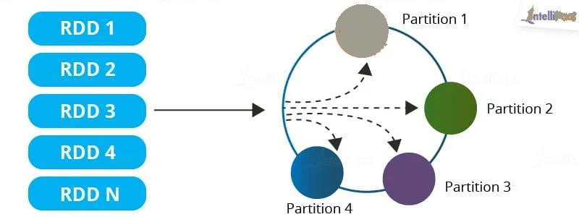
Packages in Spark: A visualisation of RDDs
RDD: Spark’s name for a data object that splits its data into multiple objects.
Notes:
RDDs are what Spark uses to hold data. It’s like a dataframe, that is then chunked, or “partitioned”, and sent to different nodes in a cluster to be processed. They are immutable. You can’t edit an RDD once it’s been created, but you can create a new one.

Slide 7






Spark and PySpark - what’s the difference?

Slide 8
Let’s get set up: Installation instructions I
Install Docker Desktop and run it
In VSCode, create a new folder called PySpark
Inside PySpark, create a file called Dockerfile (with no extension)
Paste the code from Slide 10 inside Dockerfile. Change the highlighted code to be correct.
Inside PySpark, create another folder called .devcontainer
Inside .devcontainer, create a file called devcontainer.json.
Paste the code from Slide 11 inside devcontainer.json.

Slide 9
Let’s get set up: Installation instructions II
Go to VSCode > Extensions and install the Remote Explorer extension.
On the left of the bottom toolbar in VSCode, there will now be a green “Open a Remote Window” button. Click it and select “Open Folder in Container…”
Once the Docker image is created and VSCode has reloaded, go to the Extensions tab and install Python.
Create a file called intro.ipynb.
Notes:
PySpark Development Made Simple. Using VS Code, Jupyter Notebooks, and… | by Jason Clarke | Better Programming

Slide 10
Dockerfile
ARG IMAGE_VARIANT=slim-buster
ARG OPENJDK_VERSION=your version number e.g. 19
ARG PYTHON_VERSION=your version number e.g. 3.10.9
FROM python:${PYTHON_VERSION}-${IMAGE_VARIANT} AS py
FROM openjdk:${OPENJDK_VERSION}-${IMAGE_VARIANT}
COPY --from=py / /
ARG PYSPARK_VERSION=your version number e.g. 3.3.0
RUN pip --no-cache-dir install pyspark==${PYSPARK_VERSION}
RUN pip --no-cache-dir install pandas
RUN pip --no-cache-dir install ipykernel
ENTRYPOINT ["bash"]

Slide 11
devcontainer.json
{
"name": "Dockerfile",
"context": "../",
"dockerFile": "../Dockerfile",
"extensions": ["ms-python.python", "ms-toolsai.jupyter"],
"settings": {
"terminal.integrated.shell.linux": null
},
"forwardPorts": [4050]
}

